Slide 1

Photo News
February 2022 to January 2023
Well Being Africa

Slide 2

Appreciation
WBA expresses appreciation to the Industrial Development Corporation and the DG Murray Trust for funding WBA’s
projects in 2022

Slide 3
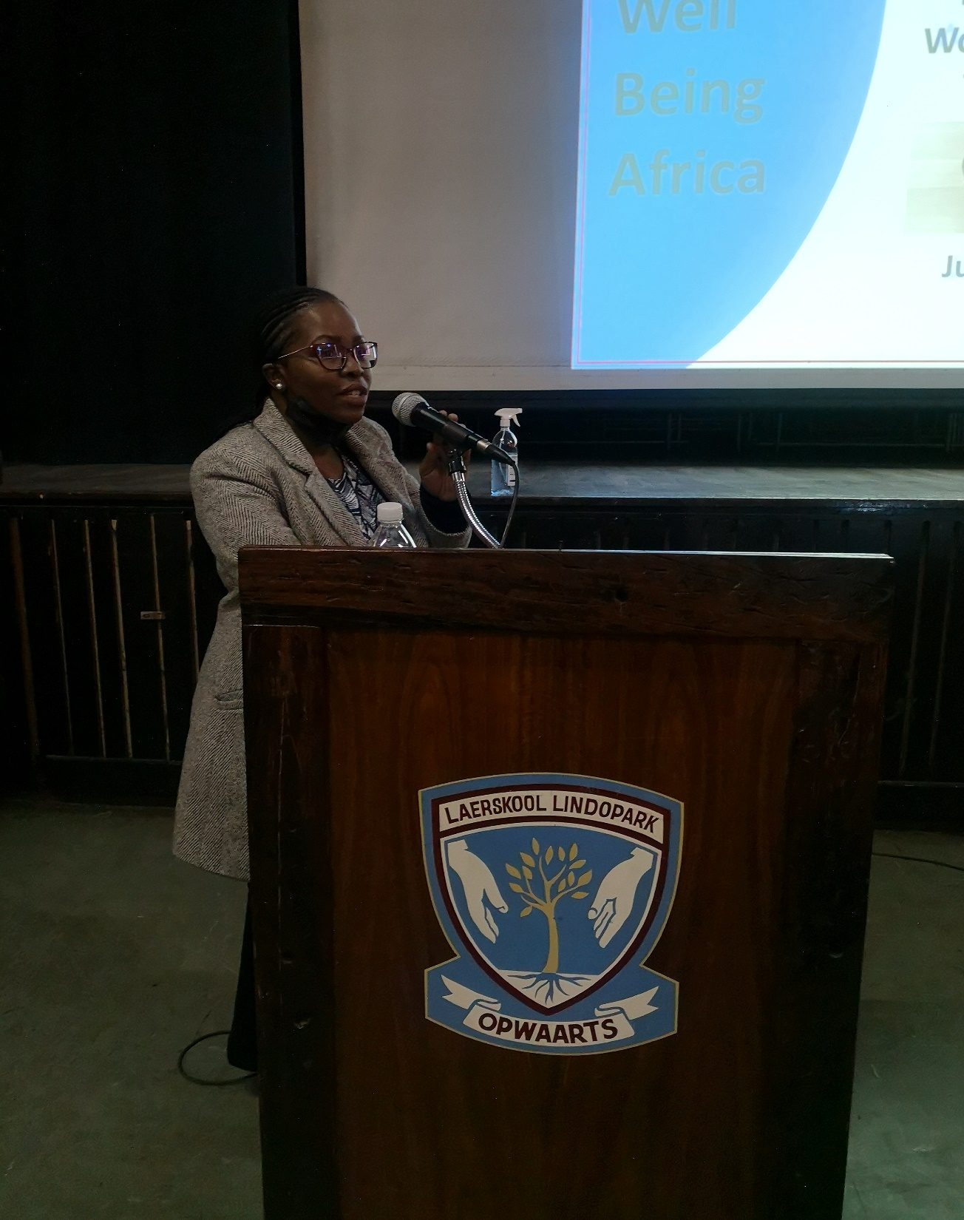
The Breastfeeding (BF) Team at Melusi on WBW 2020 celebration
Nutrition Education Workshop for Teachers
A facilitator presenting during the general session

Slide 4
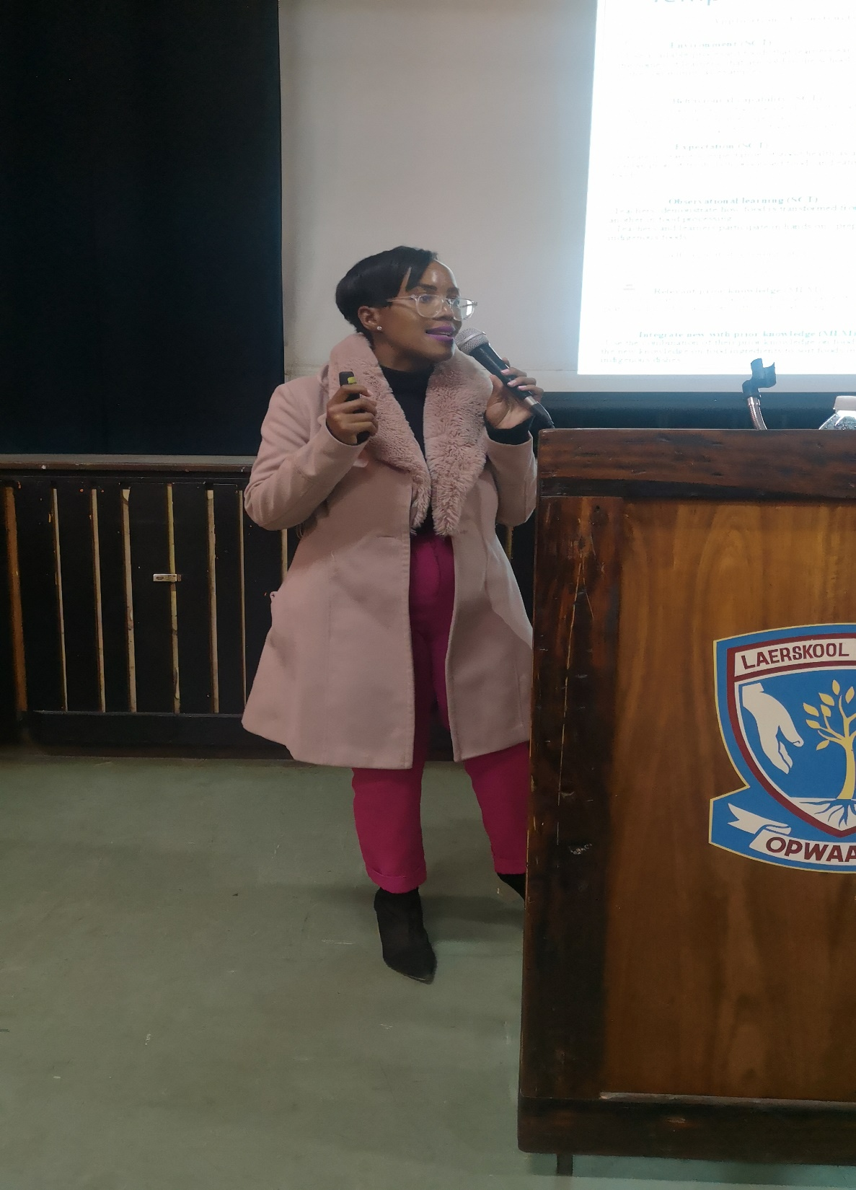
The Breastfeeding (BF) Team at Melusi on WBW 2020 celebration
Nutrition Education Workshop for Teachers
A facilitator presenting during the general session

Slide 5
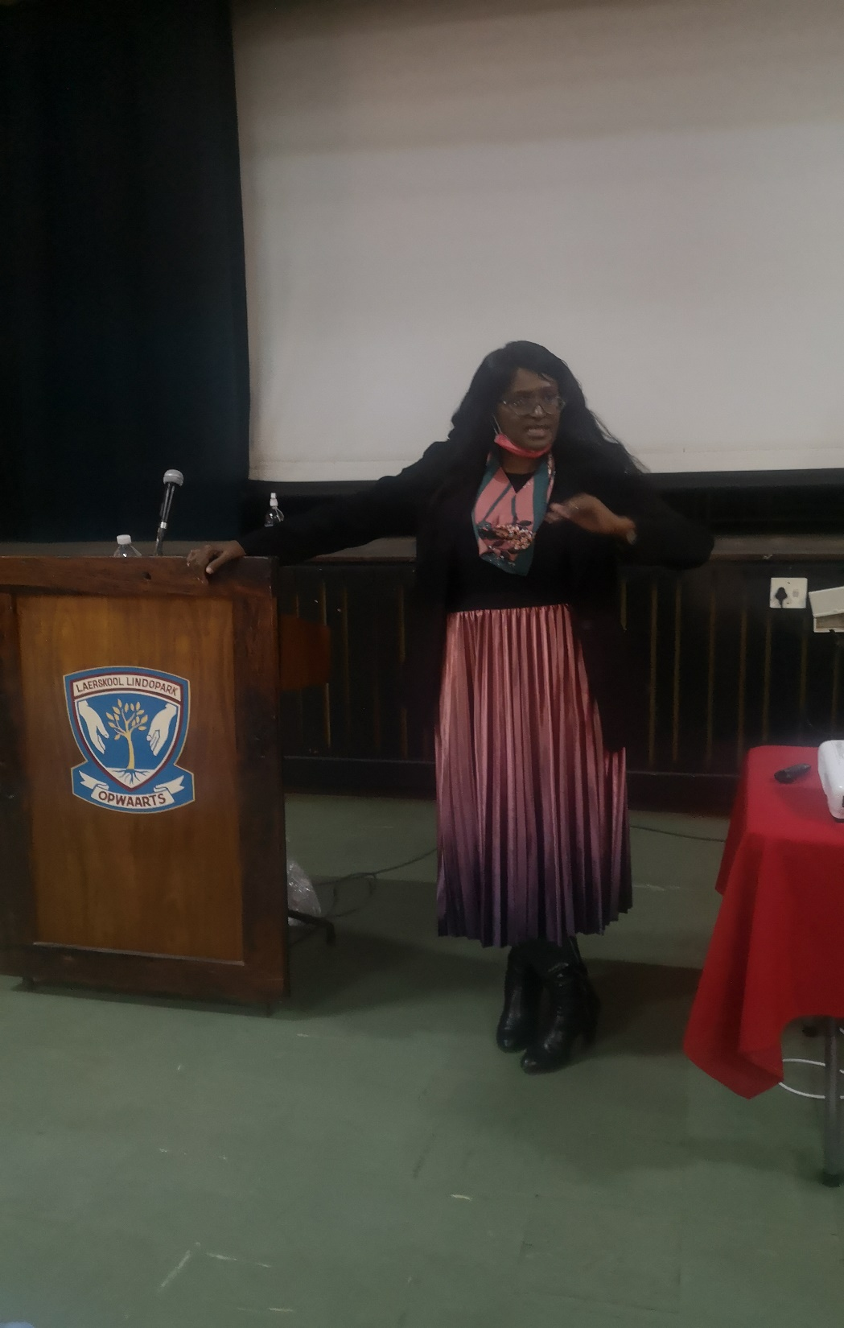
The Breastfeeding (BF) Team at Melusi on WBW 2020 celebration
Nutrition Education Workshop for Teachers
Presenting a motivational talk for participants

Slide 6
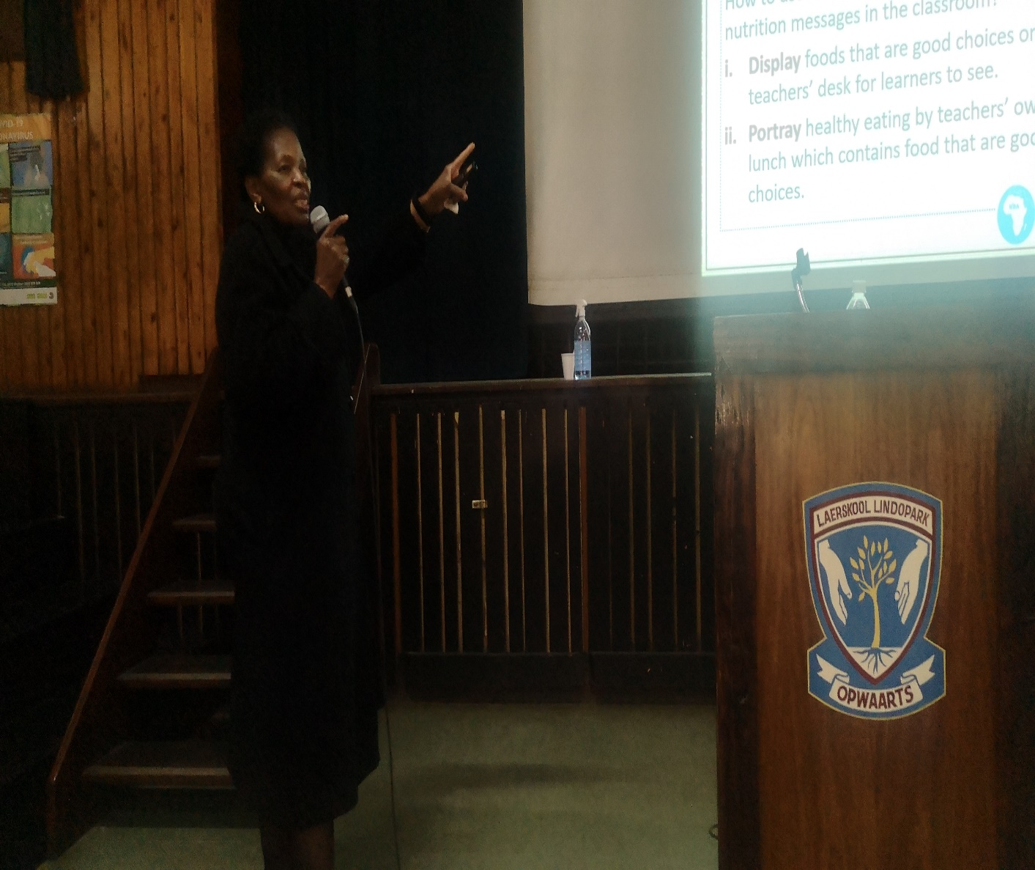
The Breastfeeding (BF) Team at Melusi on WBW 2020 celebration
Nutrition Education Workshop for Teachers
A facilitator presenting during the general session

Slide 7
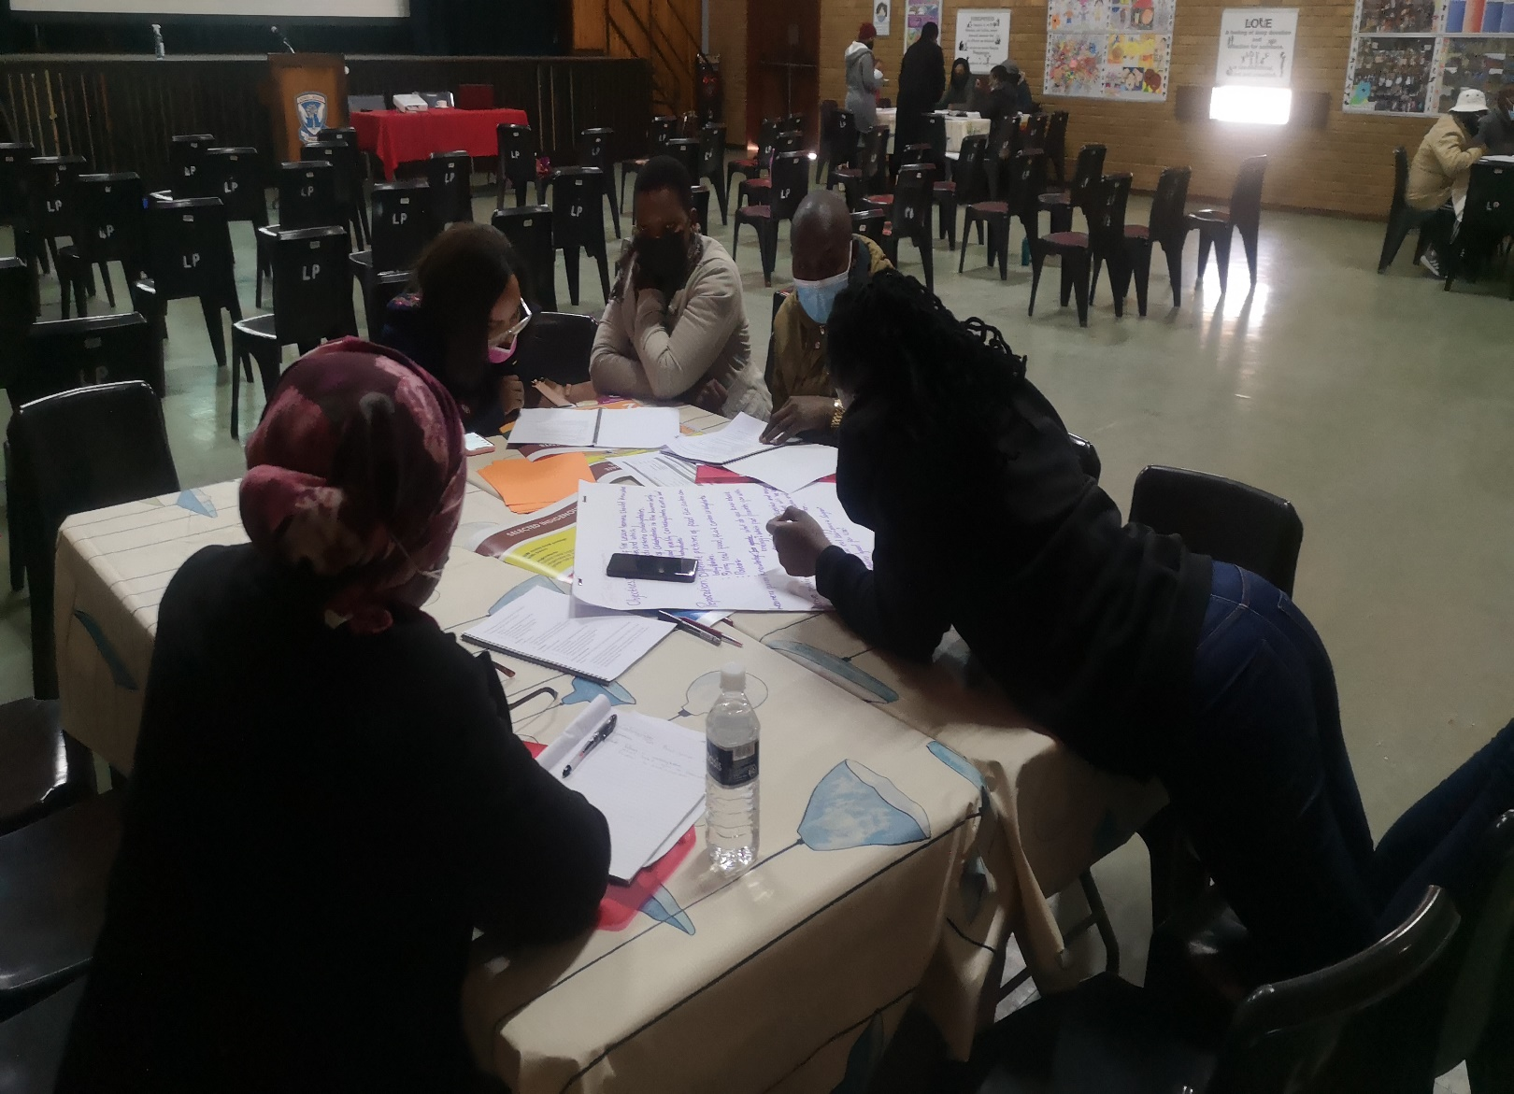
The Breastfeeding (BF) Team at Melusi on WBW 2020 celebration
Nutrition Education Workshop for Teachers
Group working session

Slide 8
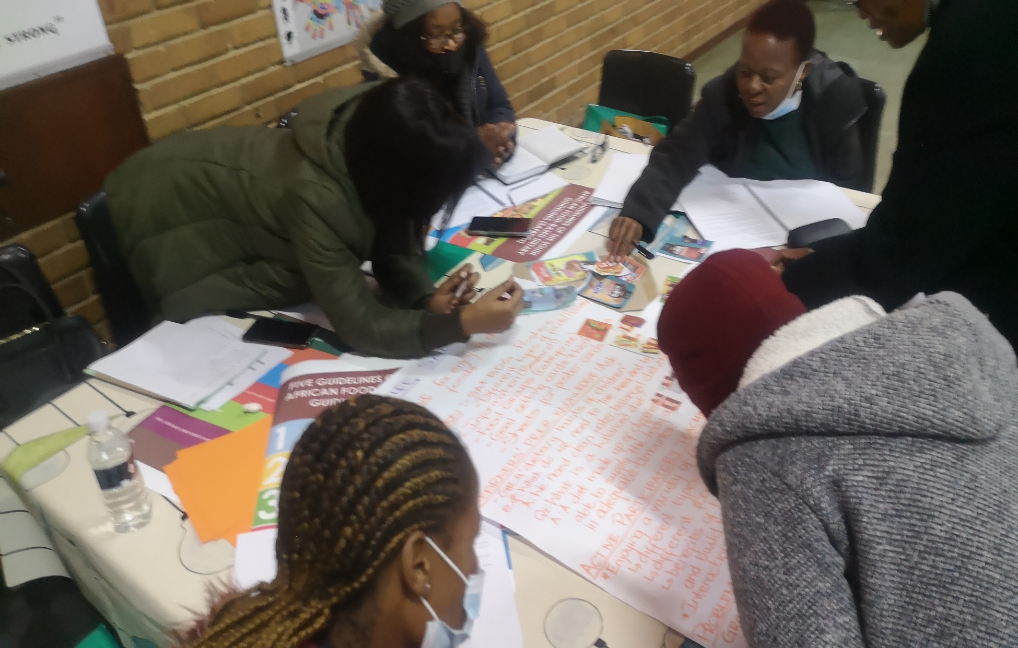
The Breastfeeding (BF) Team at Melusi on WBW 2020 celebration
Group working session at the Nutrition Education Workshop for Teachers

Slide 9
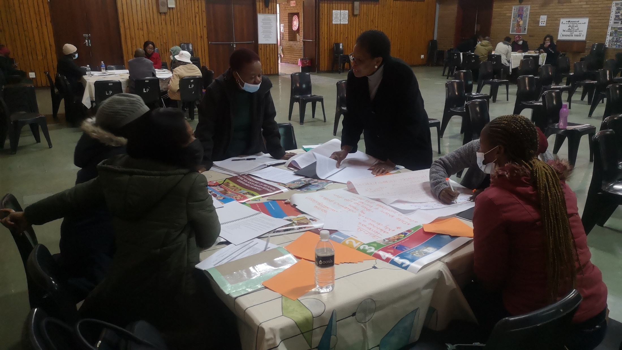
The Breastfeeding (BF) Team at Melusi on WBW 2020 celebration
Group working session at the Nutrition Education Workshop for Teachers

Slide 10
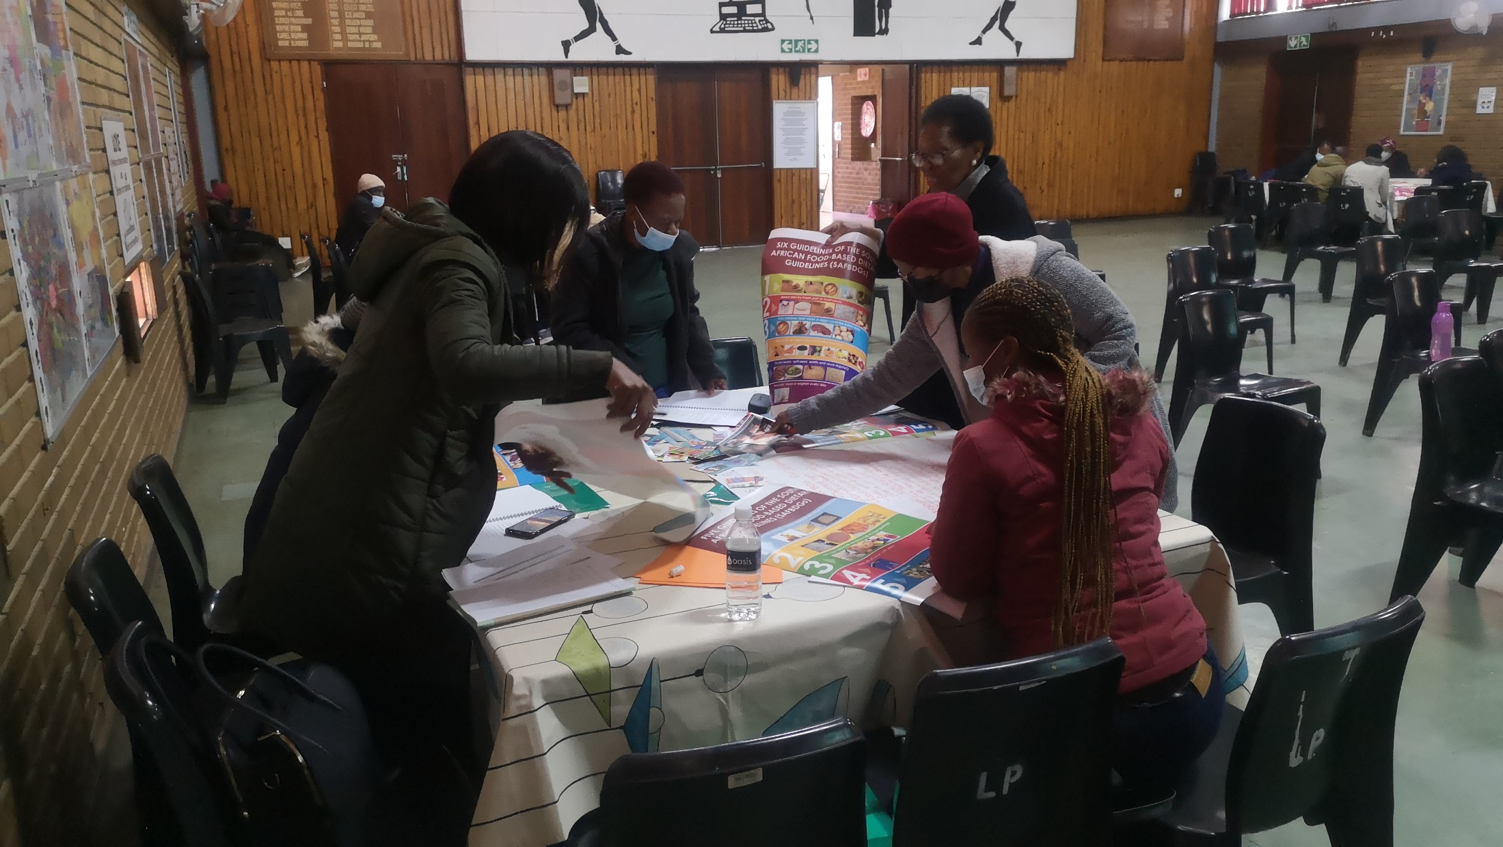
The Breastfeeding (BF) Team at Melusi on WBW 2020 celebration
Group working session at the Nutrition Education Workshop for Teachers

Slide 11
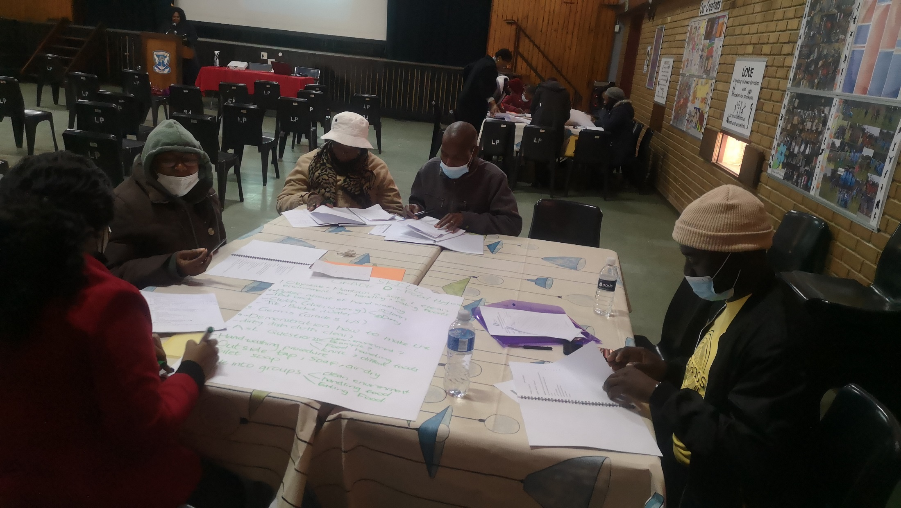
The Breastfeeding (BF) Team at Melusi on WBW 2020 celebration
Group working session at the Nutrition Education Workshop for Teachers

Slide 12
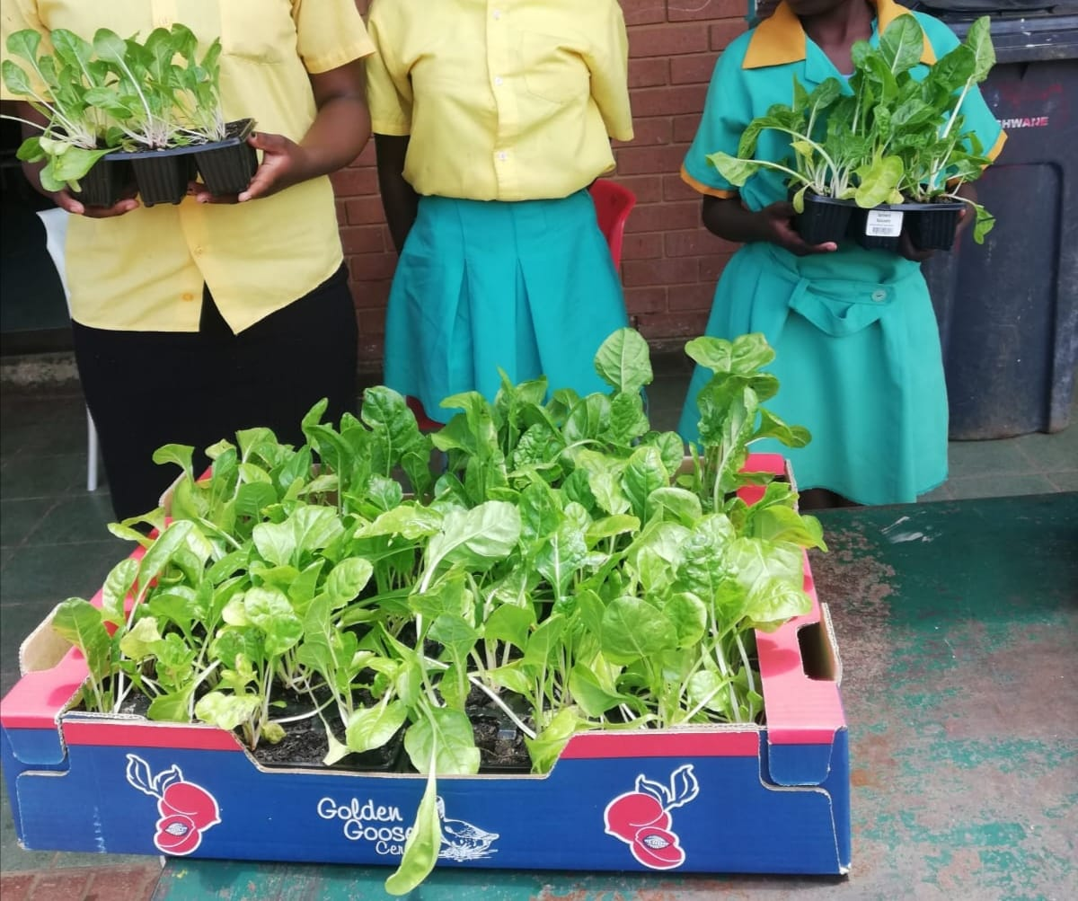
Nutrition Education Workshop for Teachers
The Breastfeeding (BF) Team at Melusi on WBW 2020 celebration
School garden support

Slide 13
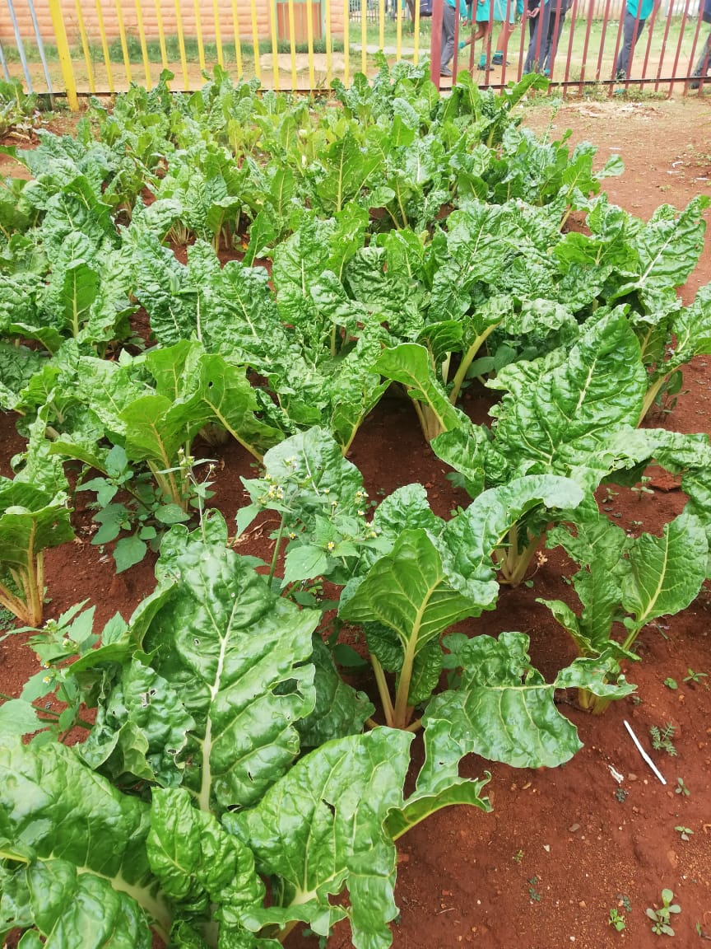
The Breastfeeding (BF) Team at Melusi on WBW 2020 celebration
Nutrition Education Workshop for Teachers
School garden support

Slide 14
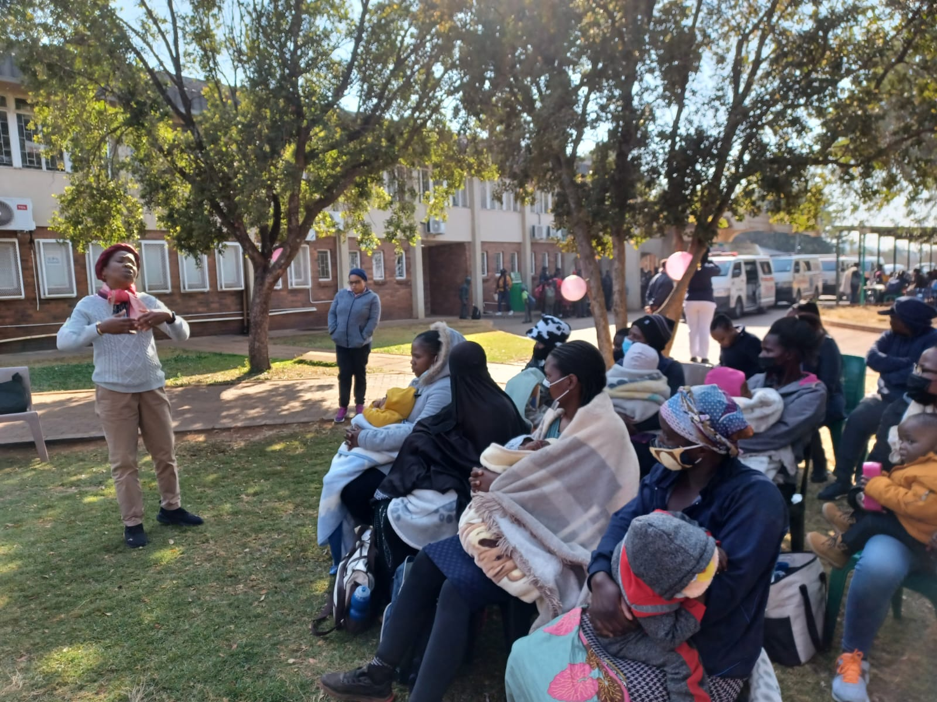
In collaboration with the Department of Human Nutrition, UP to celebrate World Breastfeeding Week 2022

Slide 15
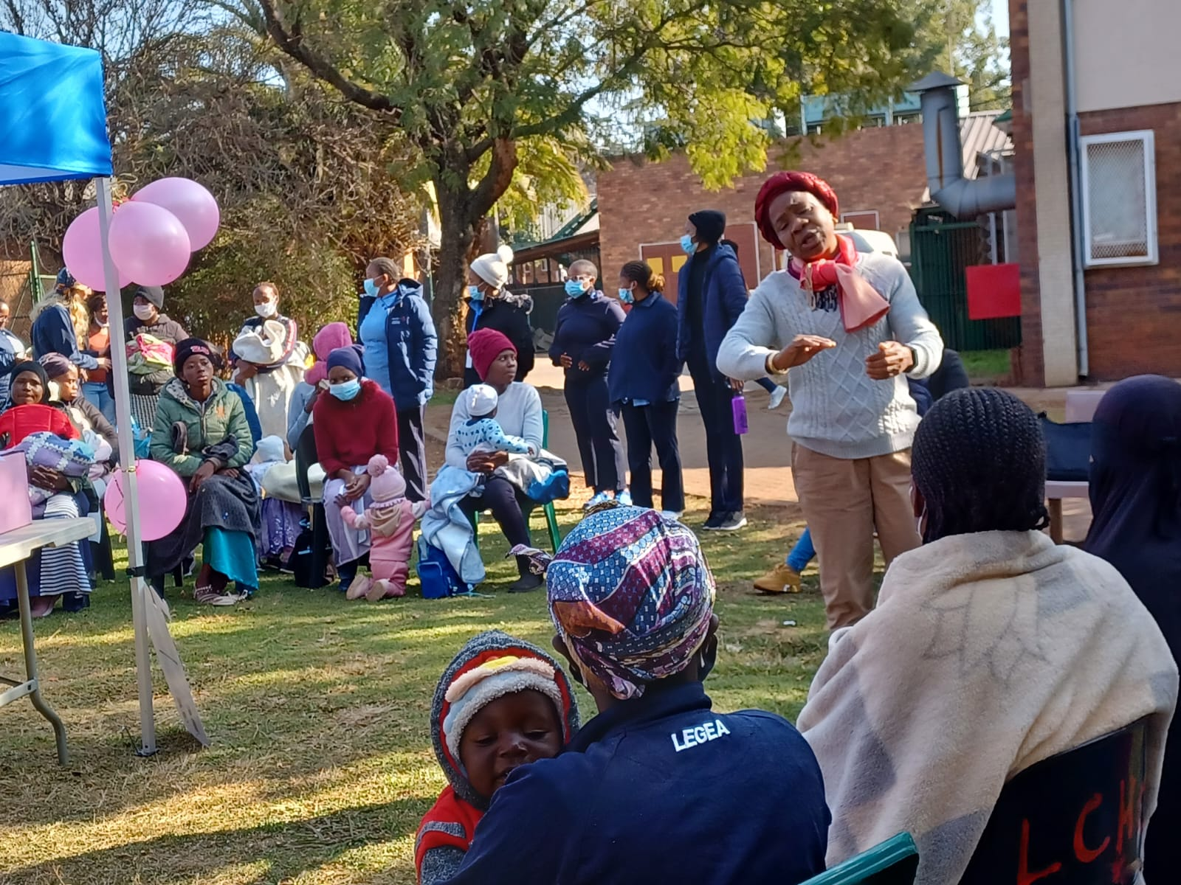
Addressing mothers at the World Breastfeeding Week 2022

Slide 16
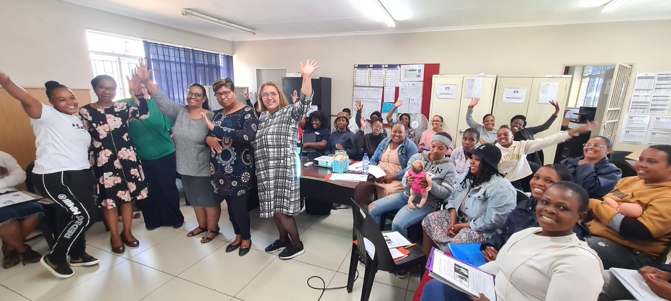
Breastfeeding Support Project
Training participants with FF supervisors and facilitators

Slide 17
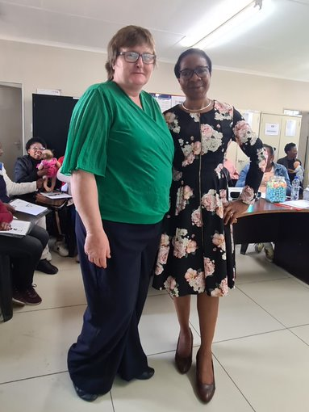
Breastfeeding Support Project
Marion and Debbie

Slide 18
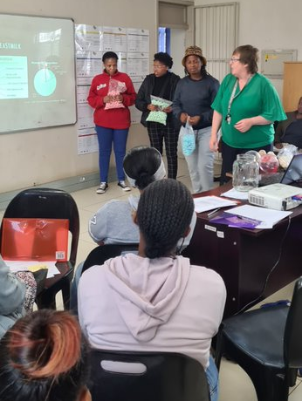
Breastfeeding Support Project
Training session and class demonstration with Marion

Slide 19
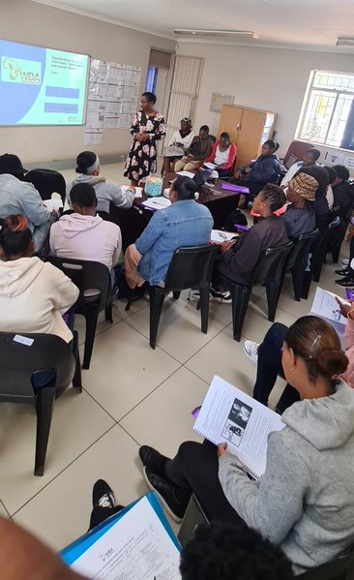
Breastfeeding Support Project
Training session with Debbie

Slide 20
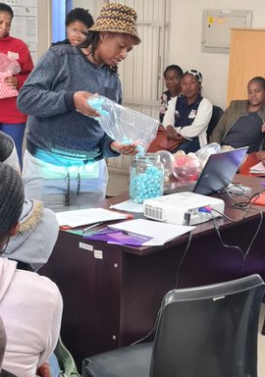
Breastfeeding Support Project
Training session at FF, Waltloo with participants illustrating the percentage composition of breastmilk

Slide 21
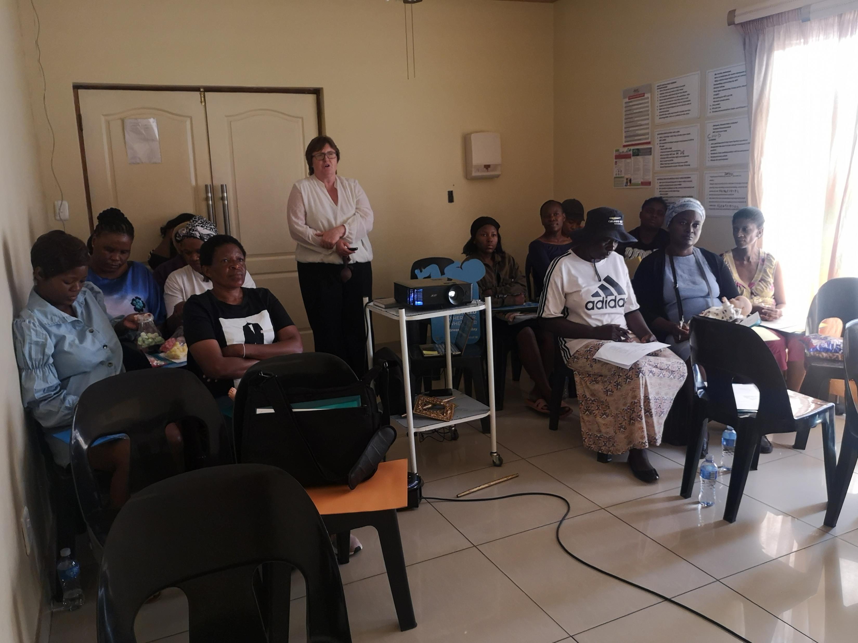
Breastfeeding Support Project
Training session at Atteridgeville with Marion

Slide 22
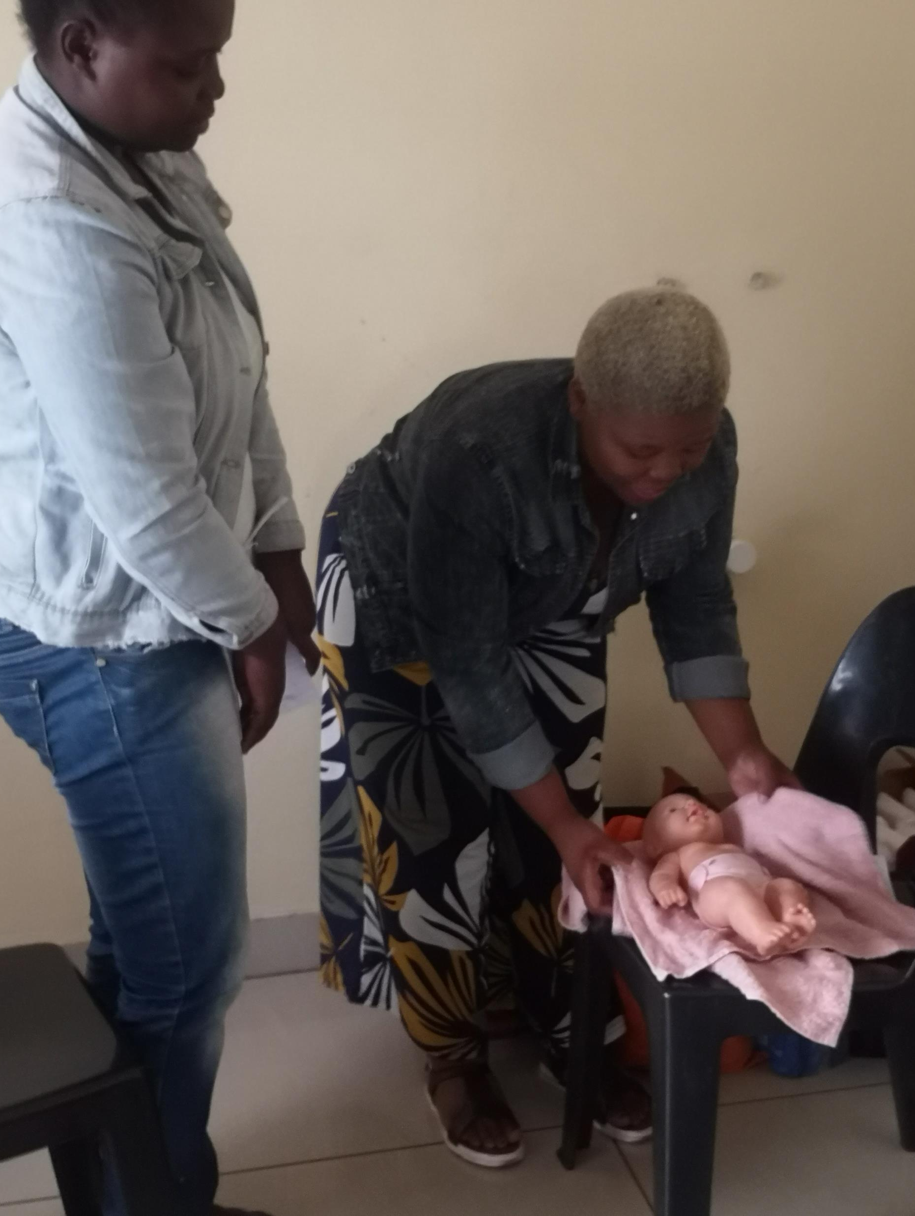
Breastfeeding Support Project
Training session at Atteridgeville with participants’ competency assessment session

Slide 23
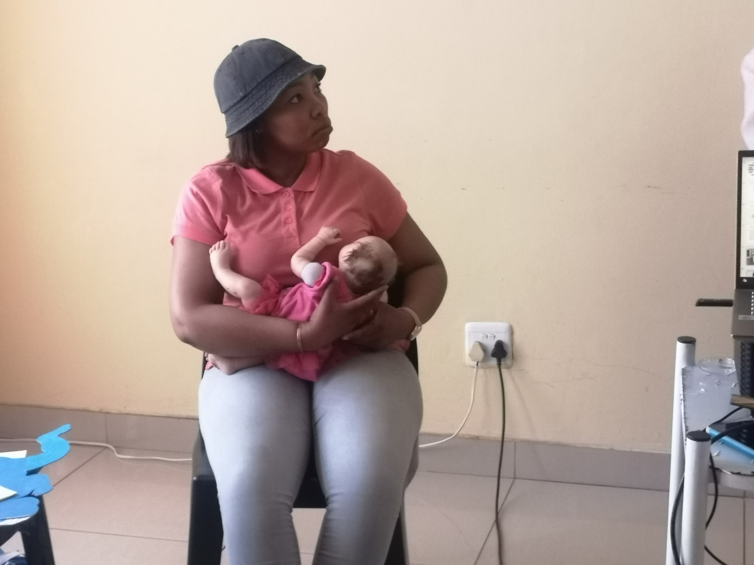
Training session at Atteridgeville with a participant illustrating a breastfeeding position
Breastfeeding Support Project
Training session at Atteridgeville with participants’ competency assessment session

Slide 24
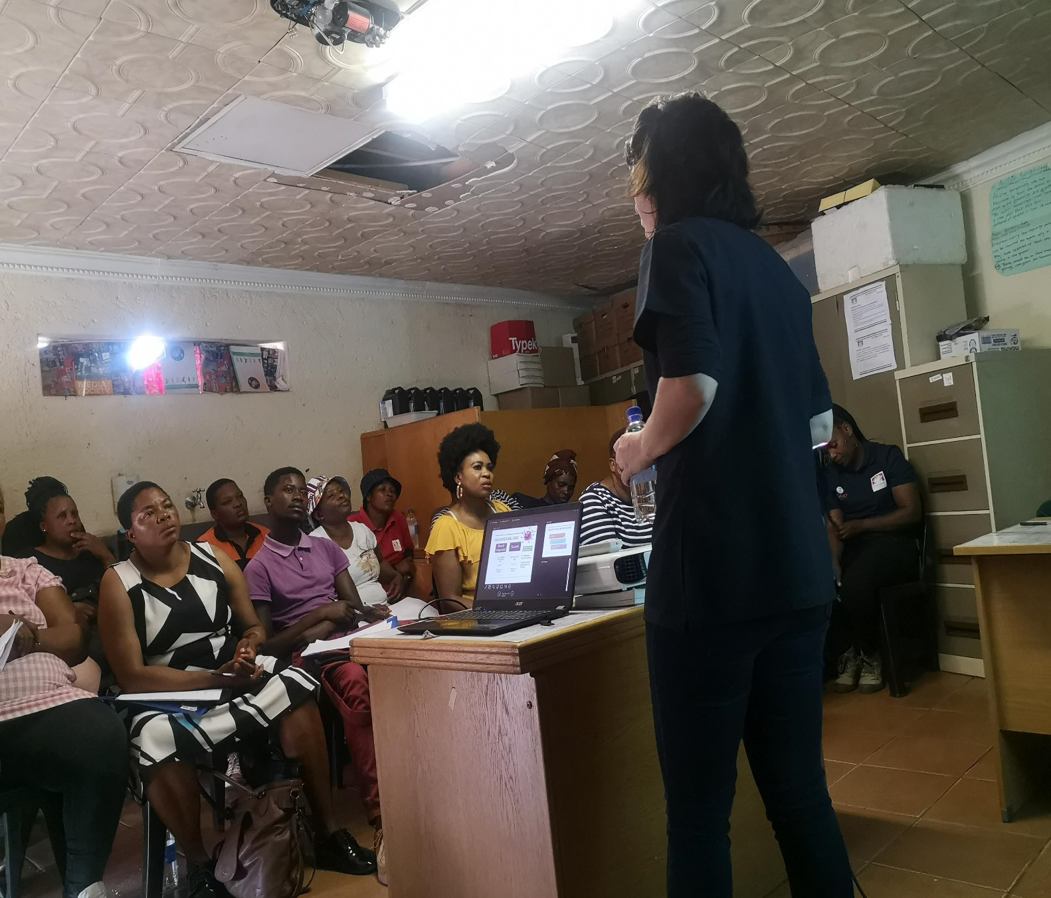
Breastfeeding Support Project
Training session at FF, OHB with Sam

Slide 25
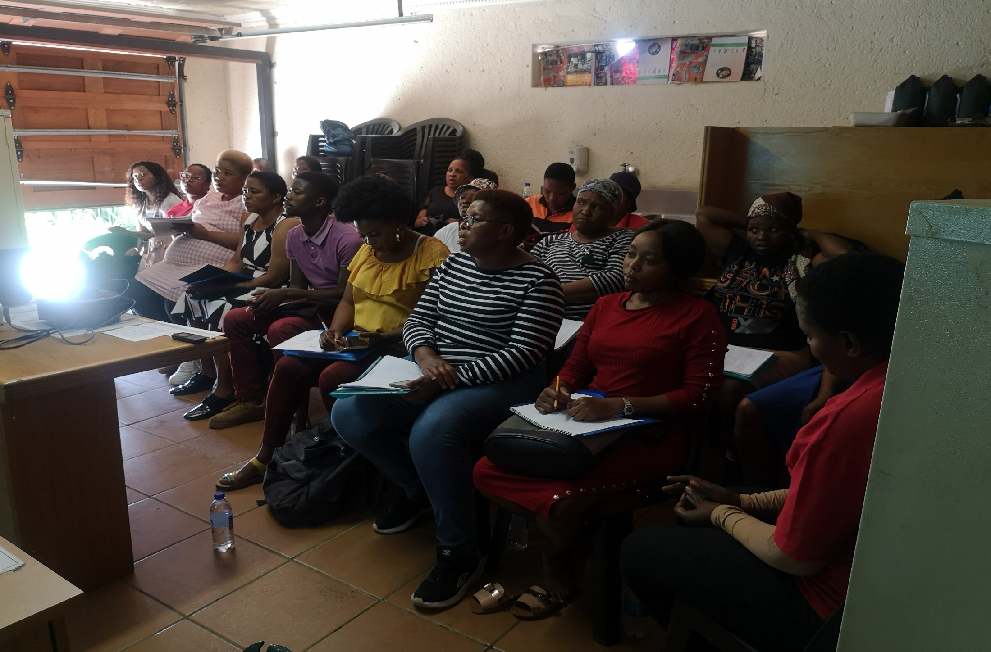
Breastfeeding Support Project
Training session at FF, OHB

Slide 26
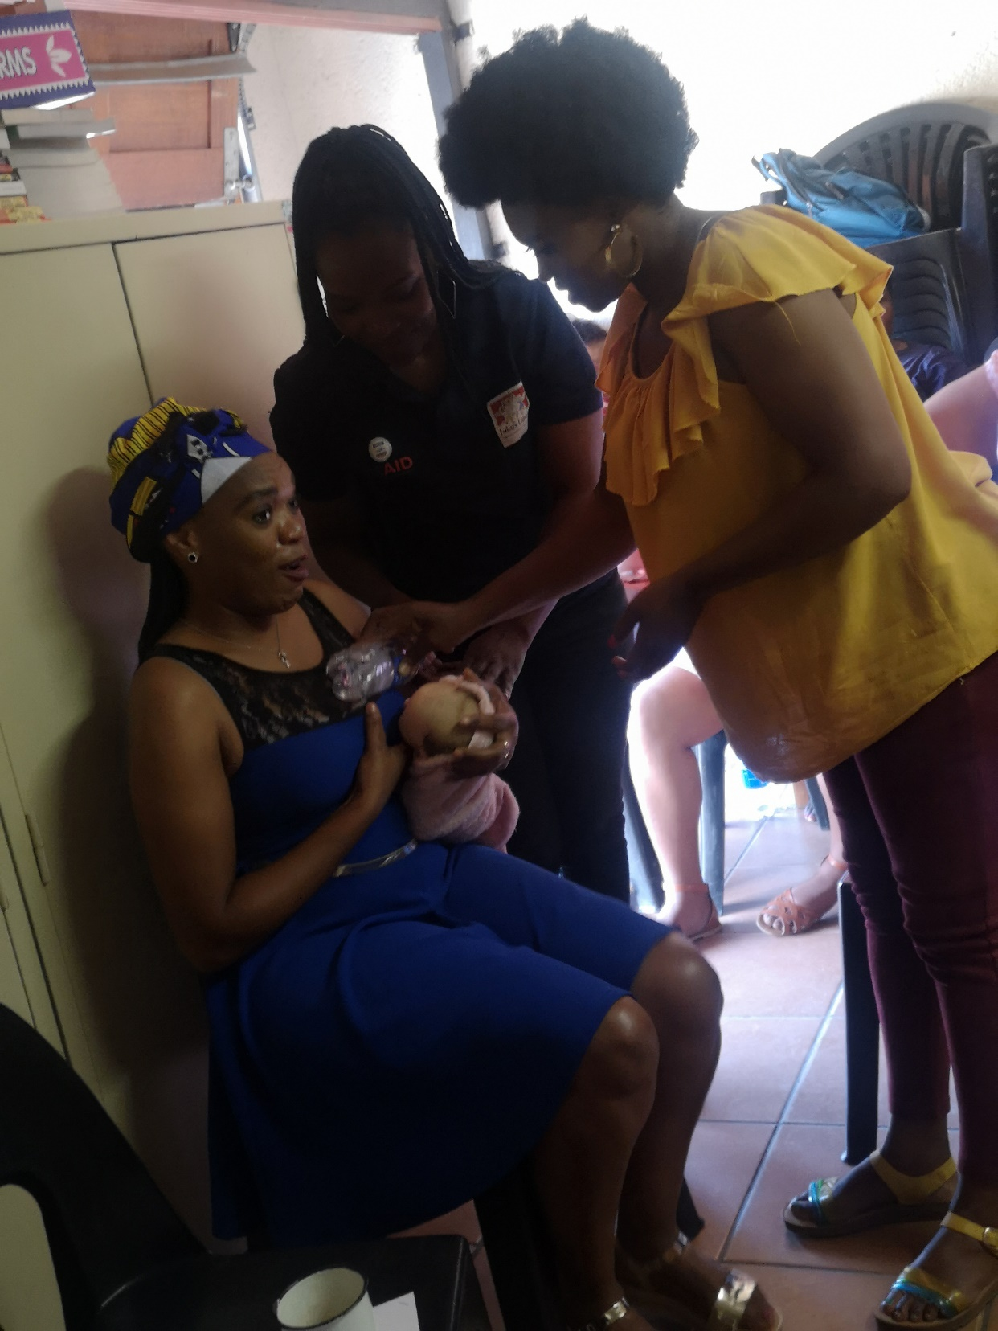
Breastfeeding Support Project
Training session at FF, OHB, with participants’ competency assessment session

Slide 27
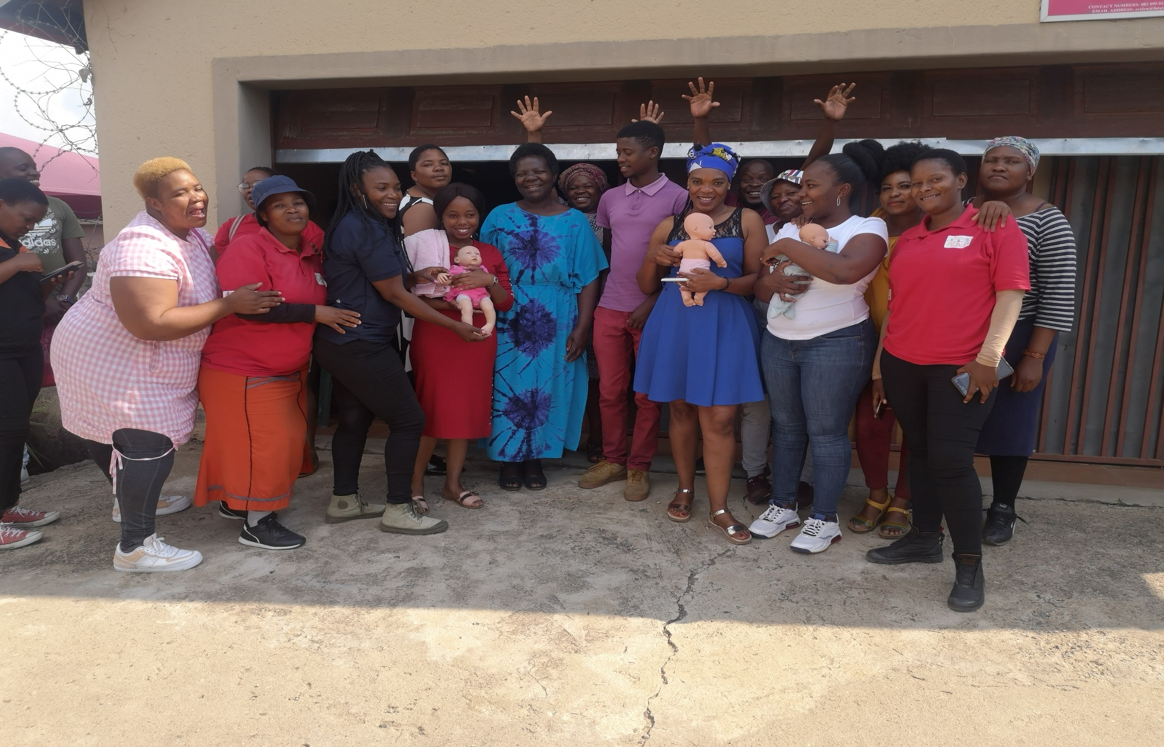
Breastfeeding Support Project
Participants group photo at the FF, OHB breastfeeding training

Slide 28
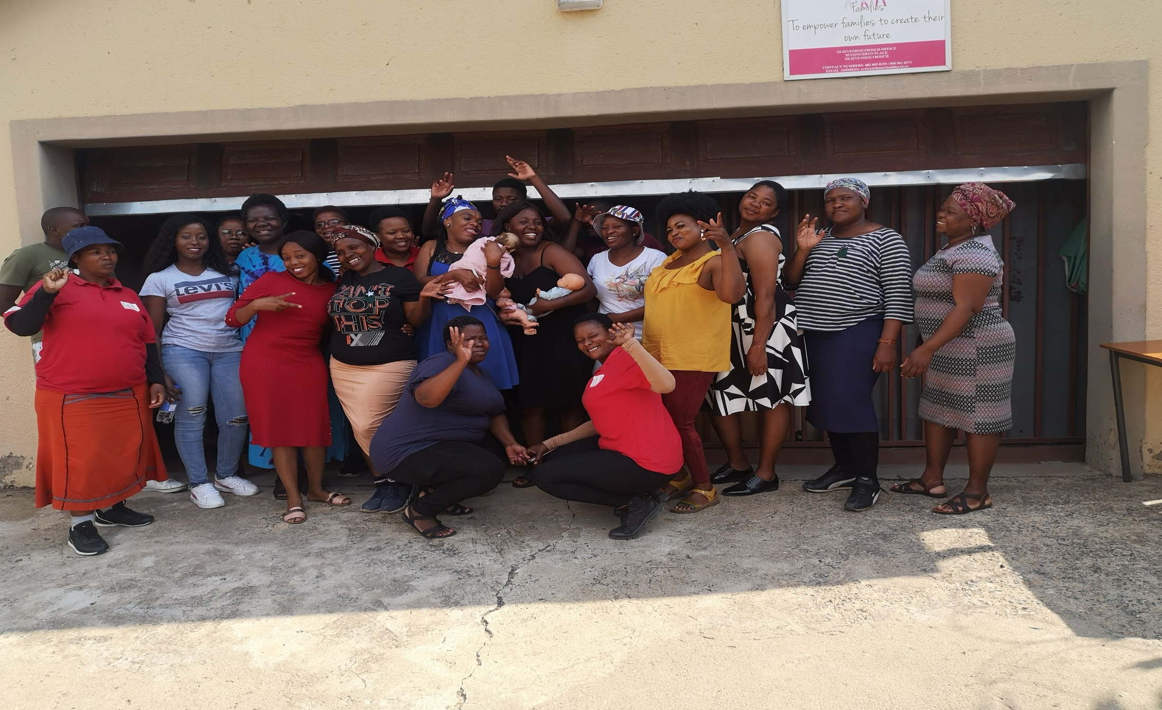
Breastfeeding Support Project
Participants group photo at the FF, OHB breastfeeding training

Slide 29
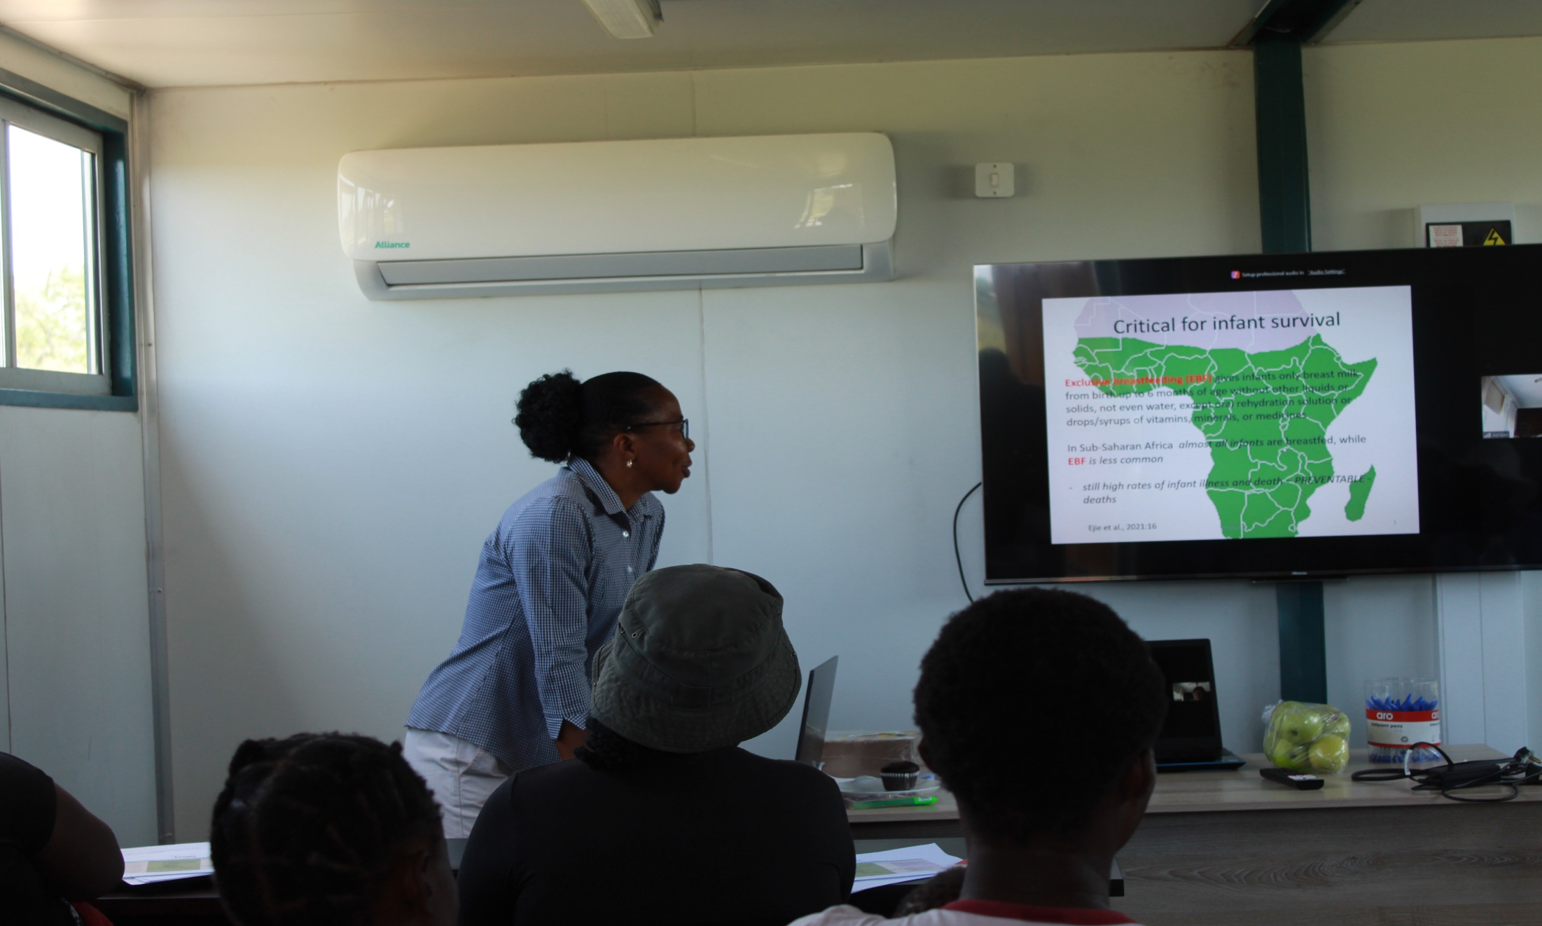
Breastfeeding Support For Mothers - Mnisi
Training session with Debbie

Slide 30
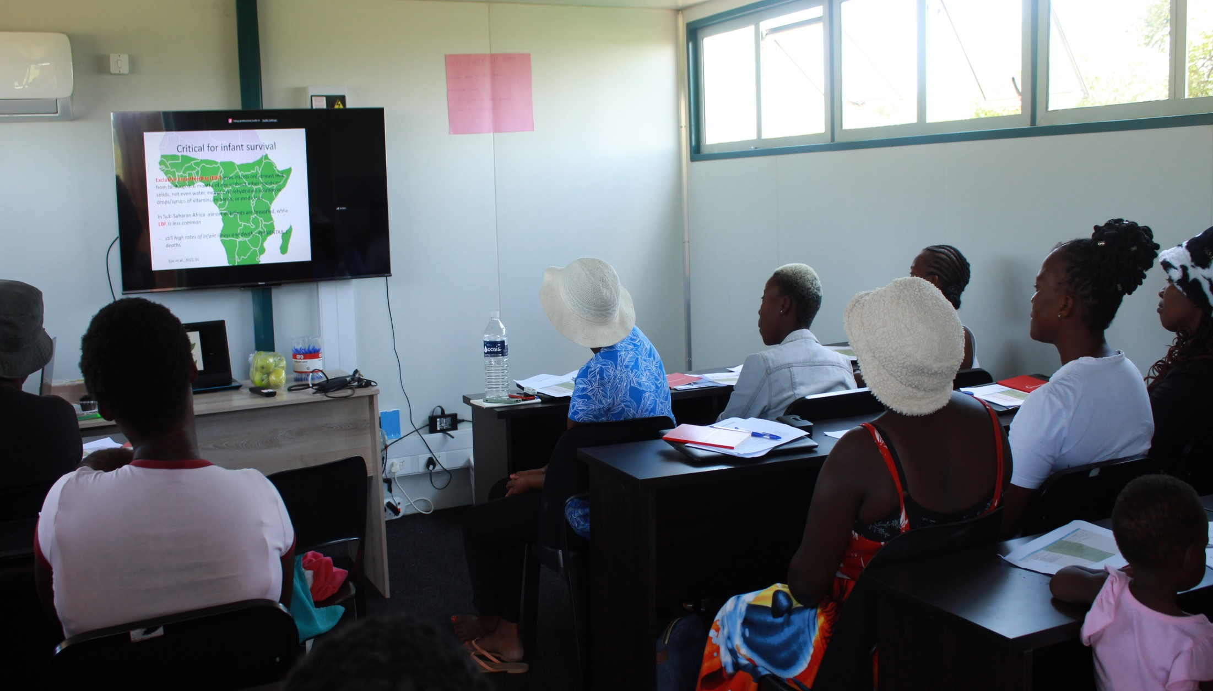
Breastfeeding Support For Mothers - Mnisi
Participants in a training session

Slide 31
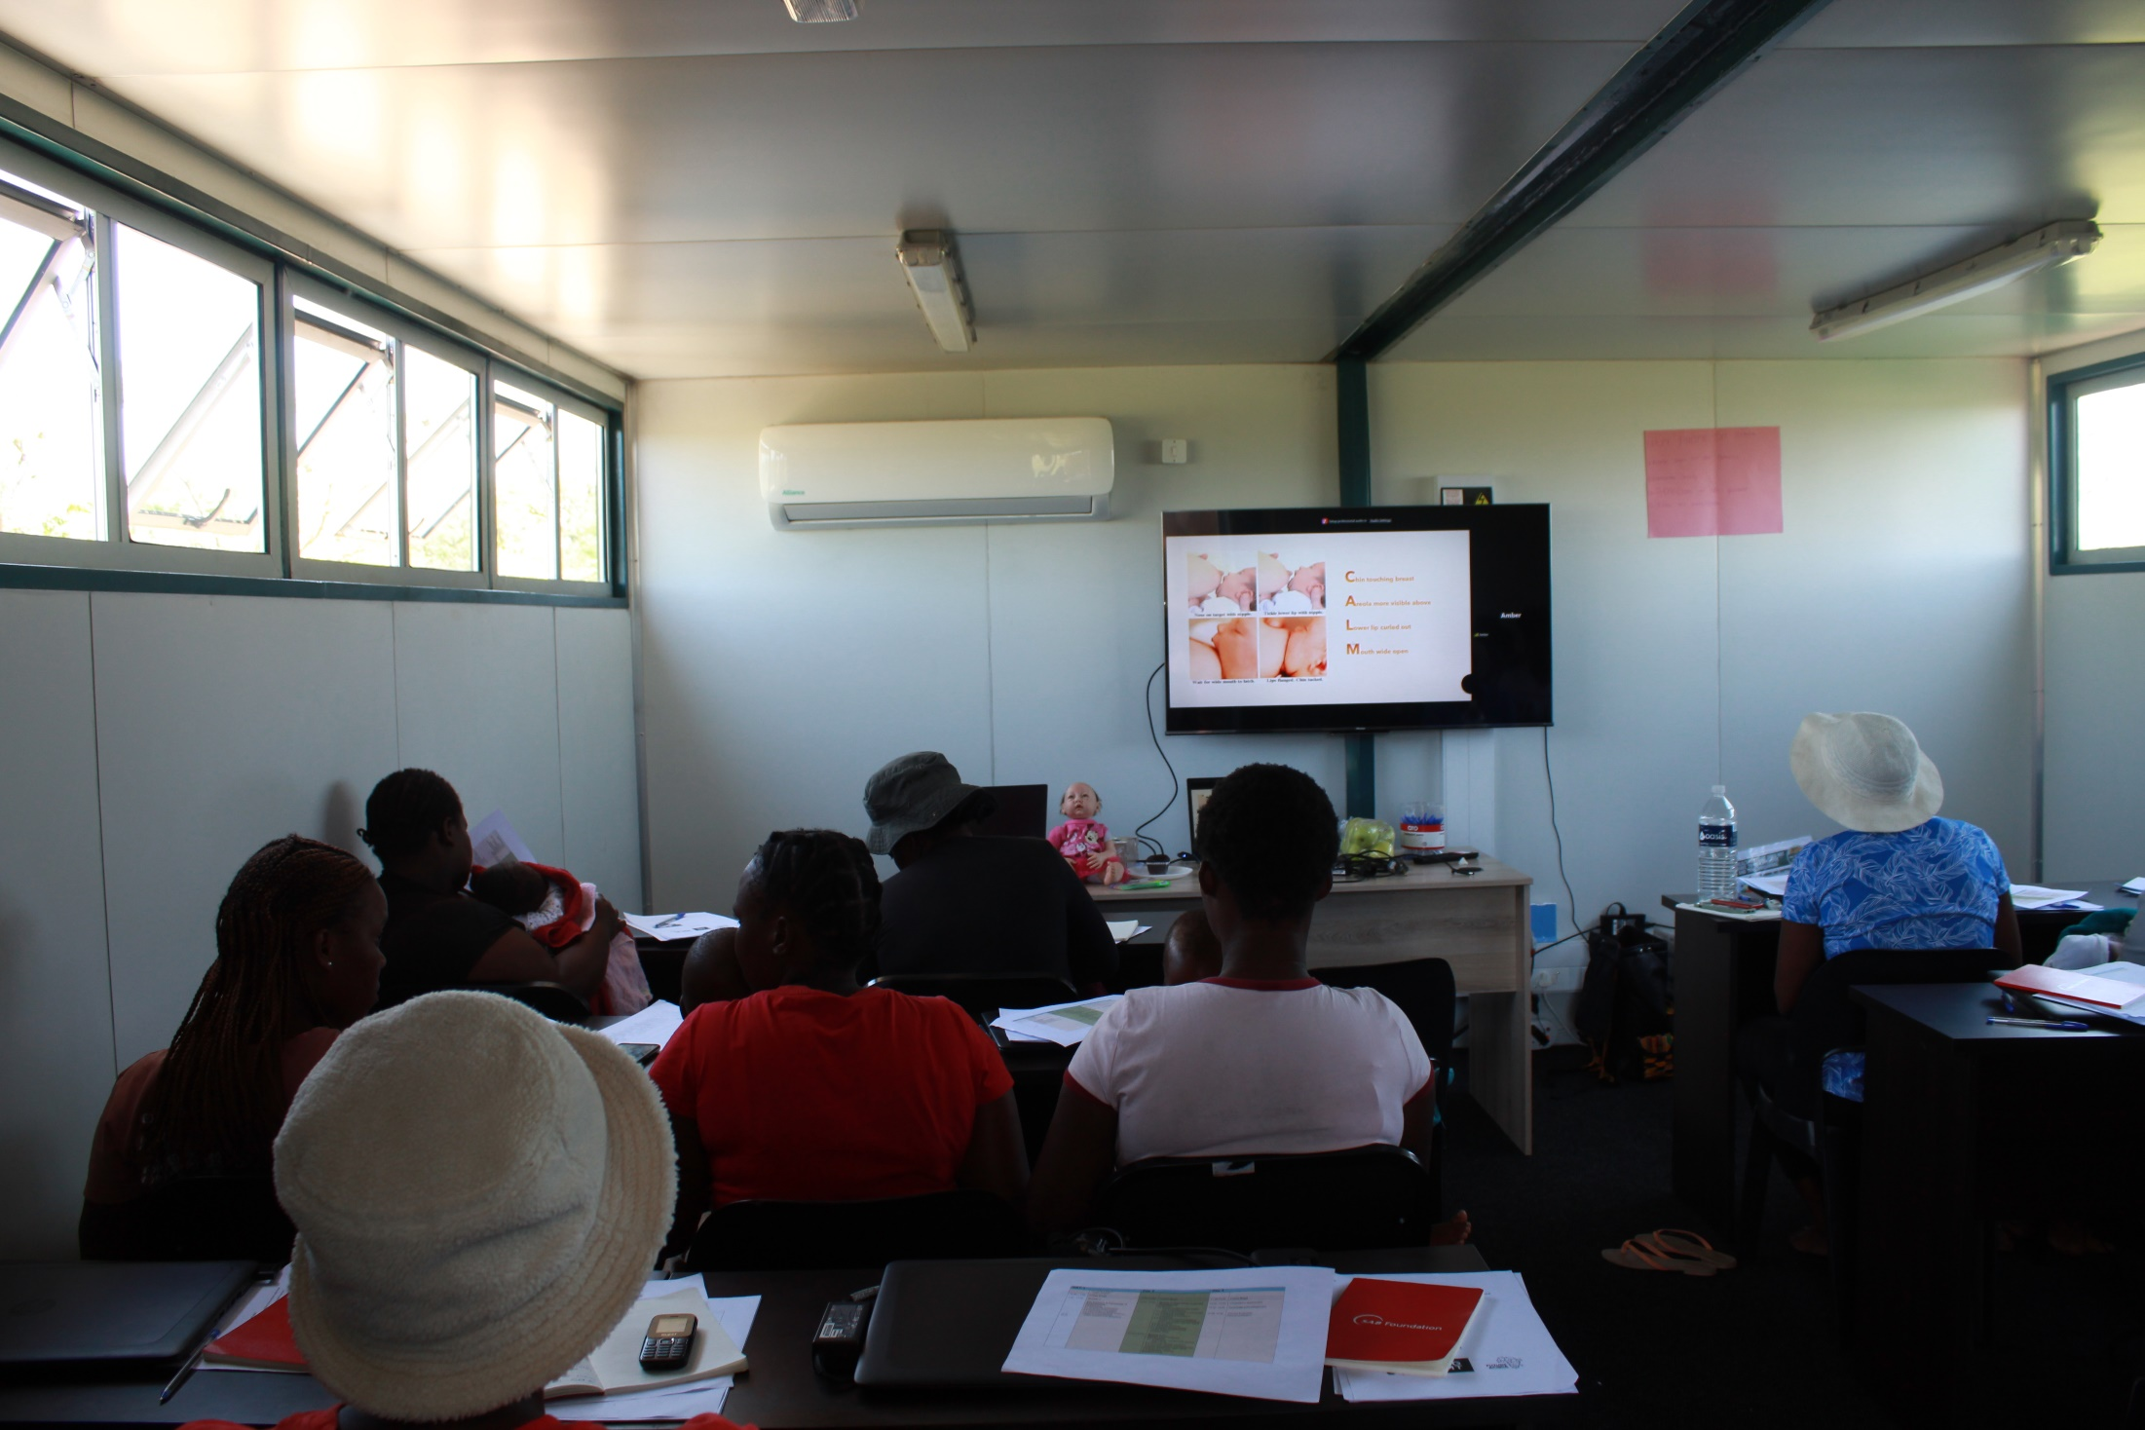
Breastfeeding Support For Mothers - Mnisi
Participants in a training session

Slide 32
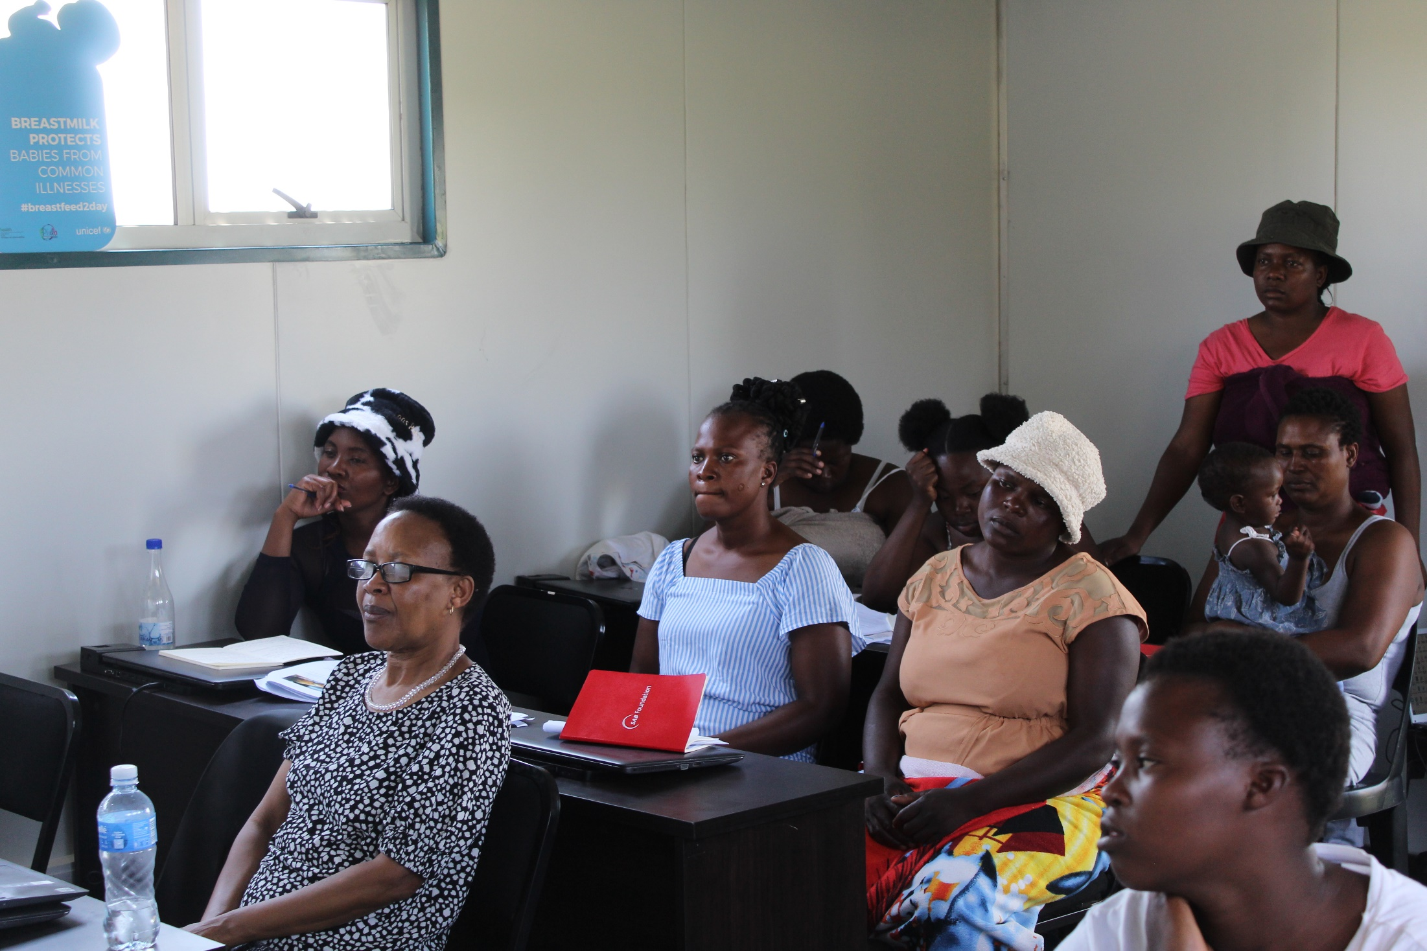
Breastfeeding Support For Mothers - Mnisi
Participants in a training session

Slide 33
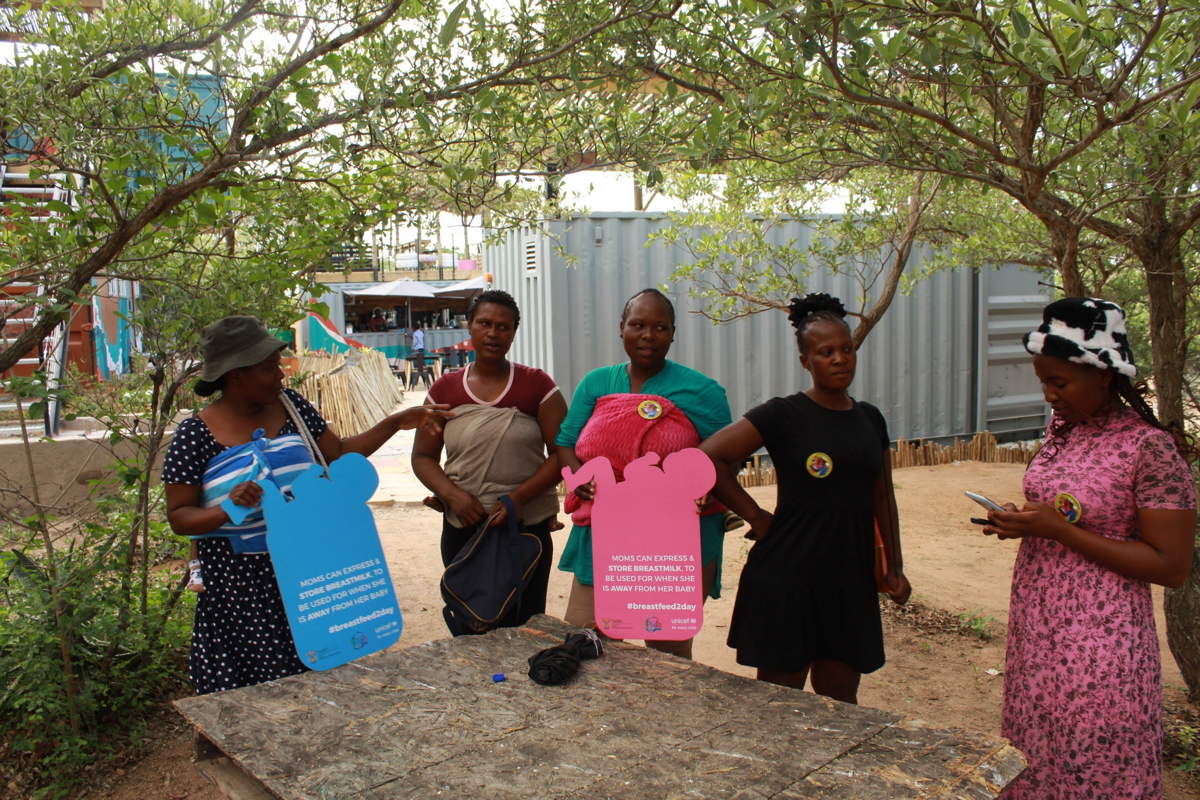
Breastfeeding Support For Mothers - Mnisi
Side talks

Slide 34
Acknowledgements
The Industrial Development Corporation (IDC) is gratefully acknowledged for funding the Nutrition Education for Teachers project.
The DG Murray Trust is gratefully acknowledged for funding the Breastfeeding support project.
The management and staff of Daspoort Policlinic for continued partnership in breastfeeding support.
The management of the Tshwane District Health for partnership in training their community health workers.
The hard-working Nutrition Education team and the Breastfeeding team of WBA are gratefully acknowledged.

